Slide 1



Motivation
Leslie Radford

Slide 2
What Is Motivation?
Direction
Intensity
Persistence
Prentice Hall, 2001
Chapter 6

Slide 3

I was saying
"I'm the greatest”
long before
I believed it.
Intensity

Slide 4
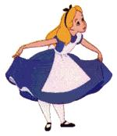

Direction

Slide 5
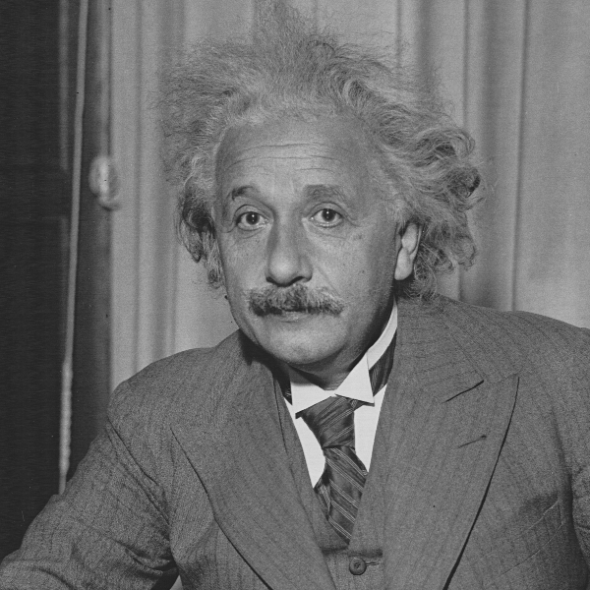
It's not that I'm so smart, it's just that I stay with problems longer.
Persistence

Slide 6
Direction
Intensity
Persistence
Prentice Hall, 2001
Chapter 6

Slide 7


Slide 8
Theories of Motivation
Needs theories
Maslow’s hierarchy of needs
Herzberg’s two factor theory
Process theories
Expectancy Theory
Goal Setting Theory

Slide 9
Maslow’s
Hierarchy
of Needs
Self
Esteem
Social
Safety
Physiological
Prentice Hall, 2001
Chapter 6

Slide 10
Questionnaire
What’s important to you at work?

Slide 11
Contrasting Views of Satisfaction and Dissatisfaction
Traditional view
Satisfaction
Dissatisfaction
Herzberg's view
Motivators
Satisfaction
No satisfaction
Hygiene Factors
No dissatisfaction
Dissatisfaction

Slide 12
Herzberg’s Two-Factor Theory
Dissatisfaction
and
demotivation
Not dissatisfied
but
not motivated
Positive
satisfaction
and motivation
Hygiene Factors
Motivational Factors
Company policies
Quality of supervision
Relations with others
Personal life
Rate of pay
Job security
Working conditions
Achievement
Career advancement
Personal growth
Job interest
Recognition
Responsibility

Slide 13
Needs Theories
Maslow
Herzberg
Self-Actualisation
Motivators
Esteem
Social
Safety
Hygiene
Factors
Physiological

Slide 14
Theories of Motivation
Needs theories
Maslow’s hierarchy of needs
Herzberg’s two factor theory
Process theories
Expectancy Theory
Goal Setting Theory

Slide 15
Expectancy Theory
(Vroom)
Individual
Effort
1
Individual
Performance
Organisational
Rewards
2
3
1. Effort-Performance relationship = Expectancy
Personal
Goals
2. Performance-Rewards relationship = Instrumentality
3. Rewards-Personal goals relationship = Valence
Prentice Hall, 2001
Chapter 6

Slide 16
How Expectancy Theory Works
Your tutor offers you £1 million if you memorise the textbook by tomorrow morning.
Expectancy
Instrumentality
Valence
Effort - Performance Link
Performance - Rewards Link
Rewards - Personal Goals Link
No matter how much effort
Your tutor does not look
There are a lot of wonderful things
you put in, probably not possible
like someone who has £1 million
you could do with £1 million
to memorise the text in 24 hours
E=0
I=0
V=1
Conclusion: Though you value the reward, you will not be motivated to do this task.

Slide 17
Goal Setting
Goals
Specific
Difficult
Accepted
Effects on Person
Directs attention
Energises
Encourages persistency
New strategies developed
Performance
Feedback

Slide 18
Motivation Theories Summary
Needs theories
Maslow’s hierarchy of needs
Herzberg’s two factor theory
Process theories
Expectancy Theory
Goal Setting Theory

Slide 19
Self-Motivation
Self-fulfilment and satisfaction
Difficult goals lead to higher performance
Motivation to act depends on the attractiveness of the outcome

Slide 20
Begin with the end in mind
What are your talents?
What is your ultimate career goal?
What can you achieve in 2 years?
What are your personal goals?

Slide 21
Motivation
Direction
Intensity
Persistence
Prentice Hall, 2001
Chapter 6

Slide 22


